Slide 1
EDA - Data Wrangling Project
Marckenrold Cadet
Alexander Burkhart

Slide 2
Outline
Introduction
Datasets
EDA
Analysis
Results

Slide 3
Introduction
USA:
2022 : 50,000 People
Male: 40,000
Female 10,000
Worldwide:
703,000 People
Men are twice as likely to commit suicide
Why?

Slide 4
Datasets
4 Datasets
Suicide Rate worldwide
GDP per Capita
Happiness Report
Bankruptcies
Timeframe: 2011 - 2019

Slide 5
EDA

Slide 6
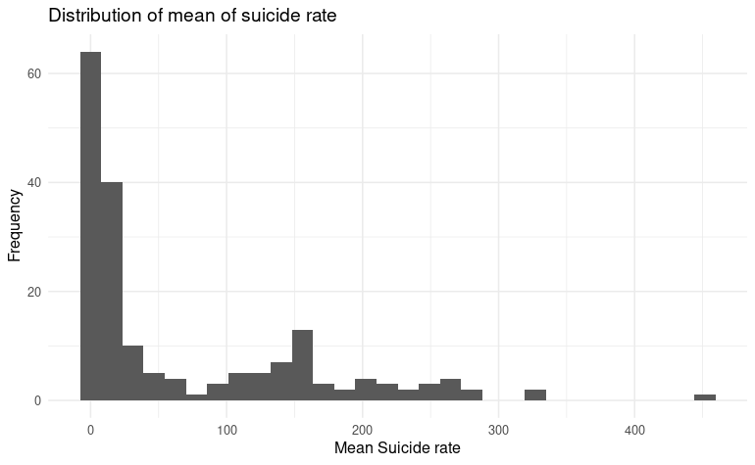
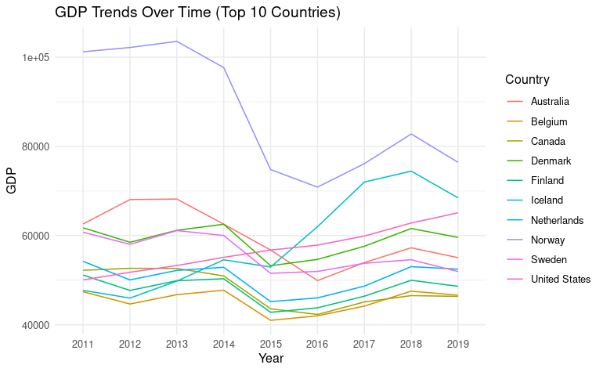
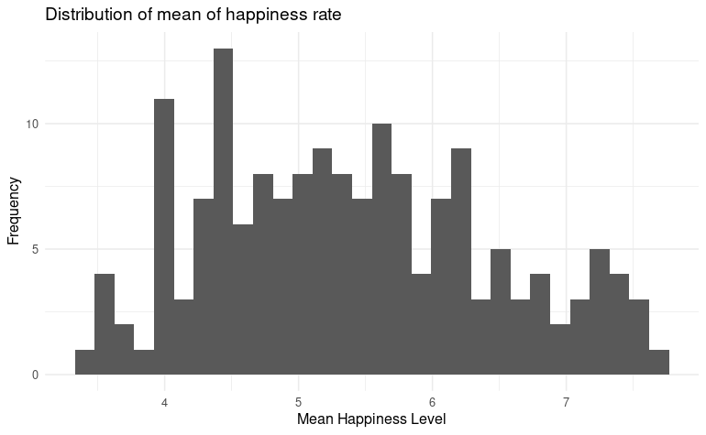

Slide 7
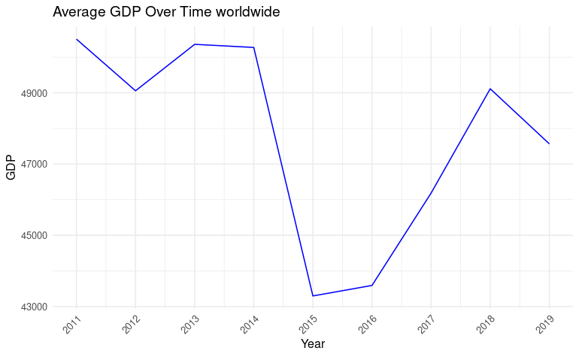
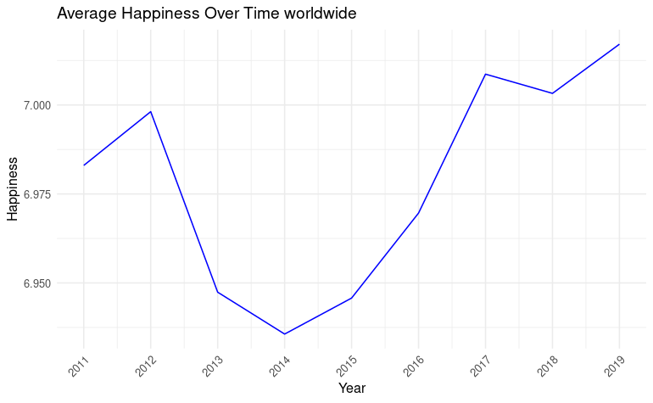
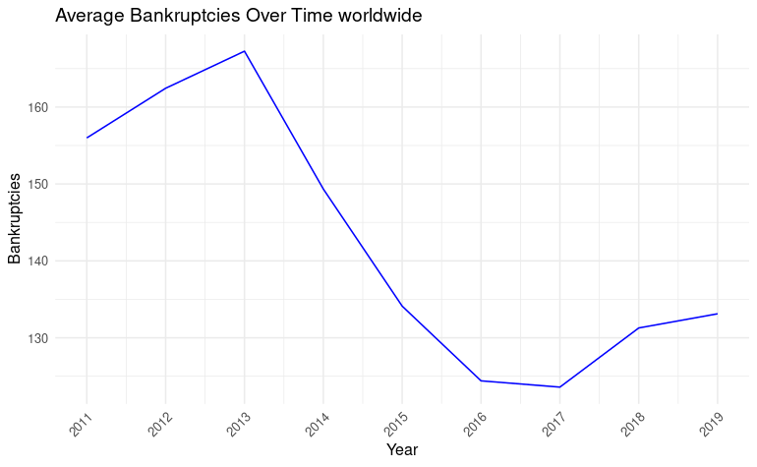
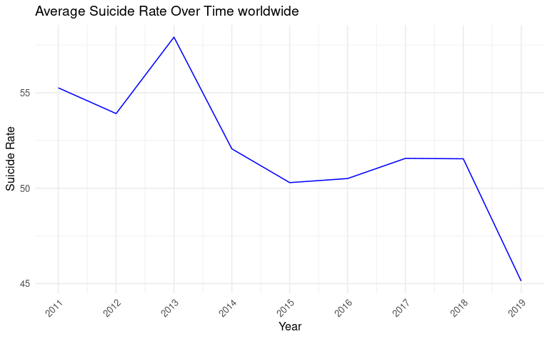

Slide 8
Analysis

Slide 9


Comparisons - Suicide - Happiness
Most Happy vs Suicide
Least Happy vs Suicide

Slide 10


Comparisons - Suicide - GDP
Wealthy vs Suicide
Poor vs Suicide

Slide 11


Comparisons - Suicide - Bankruptcies
Most Bankruptcies vs Suicide
Least Bankruptcies vs Suicide

Slide 12
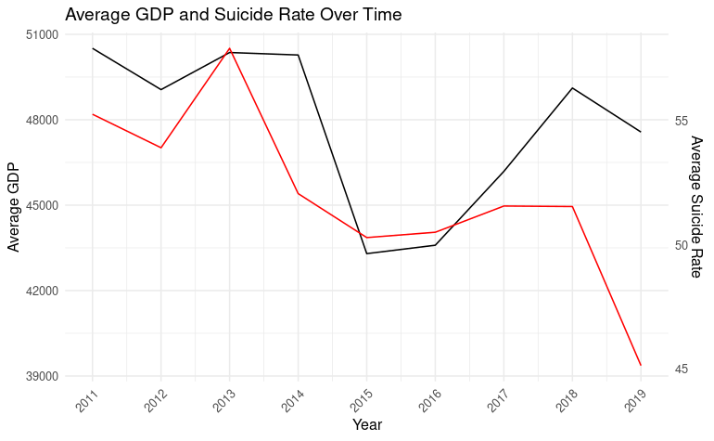
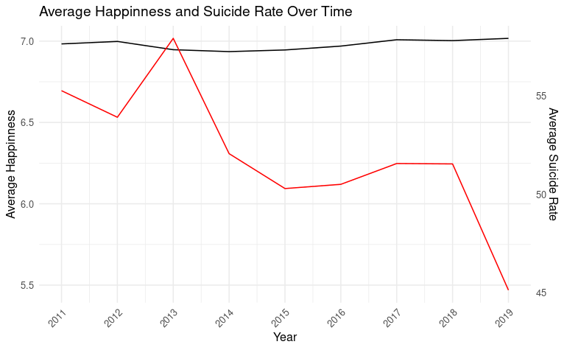
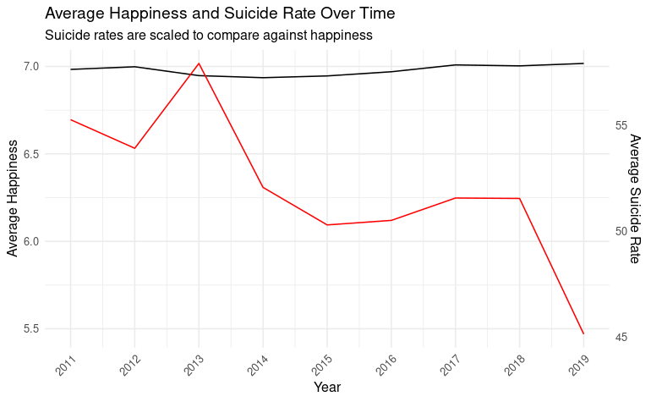

Slide 13
In depth Analysis Germany

Slide 14
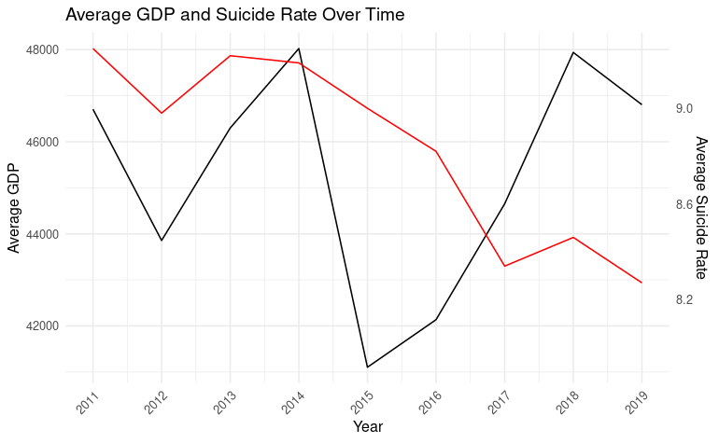
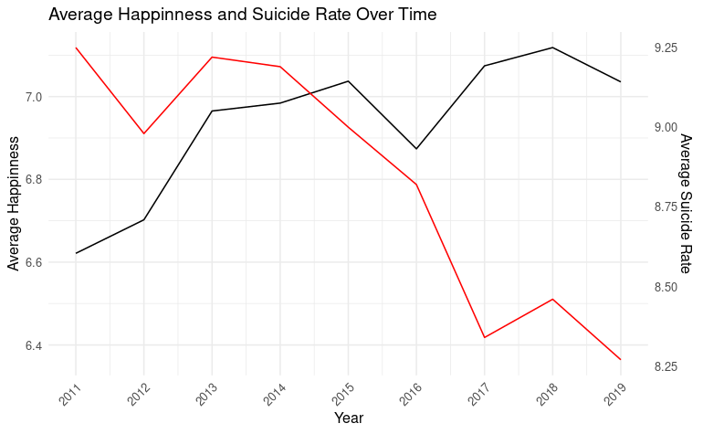
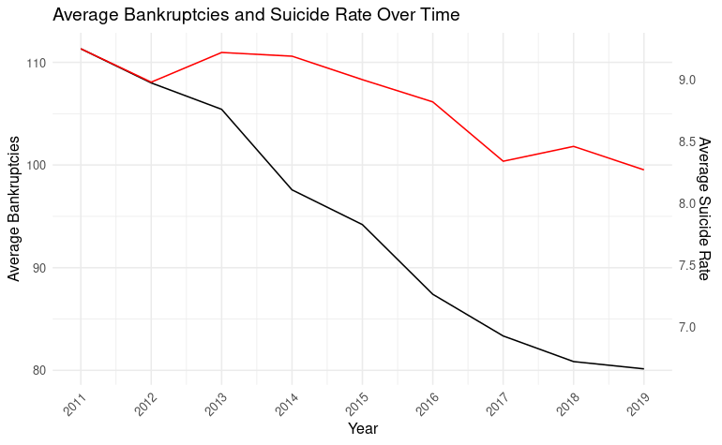

Slide 15
In depth Analysis South Africa

Slide 16
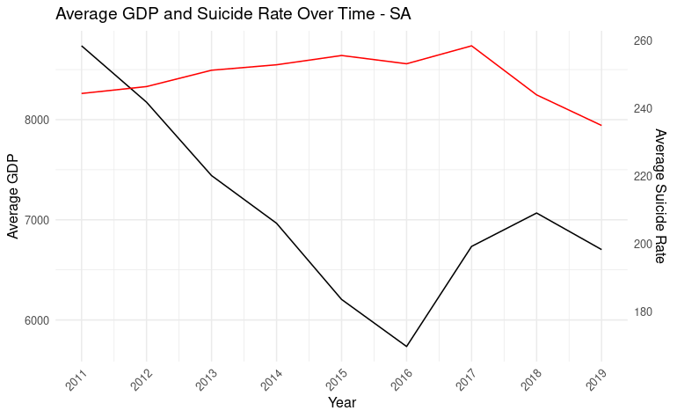
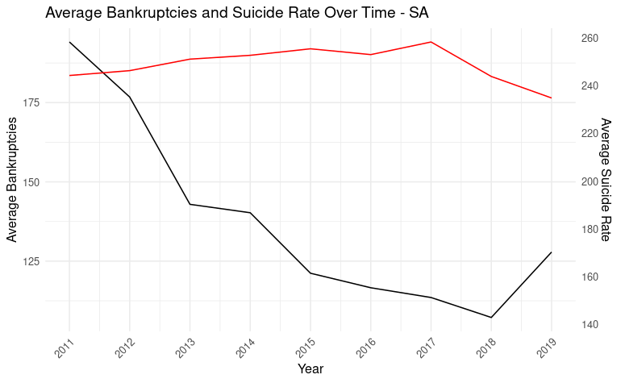
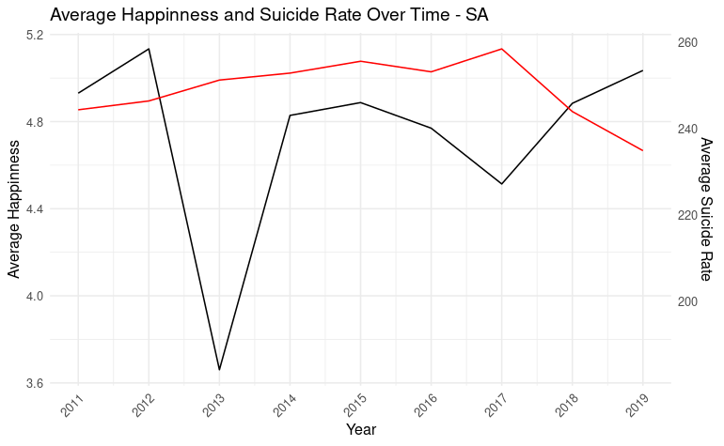

Slide 17
Power BI

Slide 18
Results
Worldwide: No correlation
Germany: No correlation
South Africa: No correlation

Slide 19
Improvements
Include:
Alcohol / Drug usage
Unemployment rates
Sunshine hours
Socio- Economic:
political stability
social conflicts
Timeframe
monthly

